Slide 1
Final Project
Fabiolah Jones
Summer 2025
Data Science Programming

Slide 2

The dataset in this project is regarding Southern California students’ perception of their safety in school .
The dataset can be found at:
https://usc-geohealth-hub-uscssi.hub.arcgis.com/datasets/perceptions-of-school-safety/explore?location=34.117758%2C-117.162695%2C7.91&showTable=true

Slide 3

Are there factors that affect a student’s perception of their safety in school?

Slide 4

Does gender play a role in 7th graders who feel very safe in school?

Slide 5
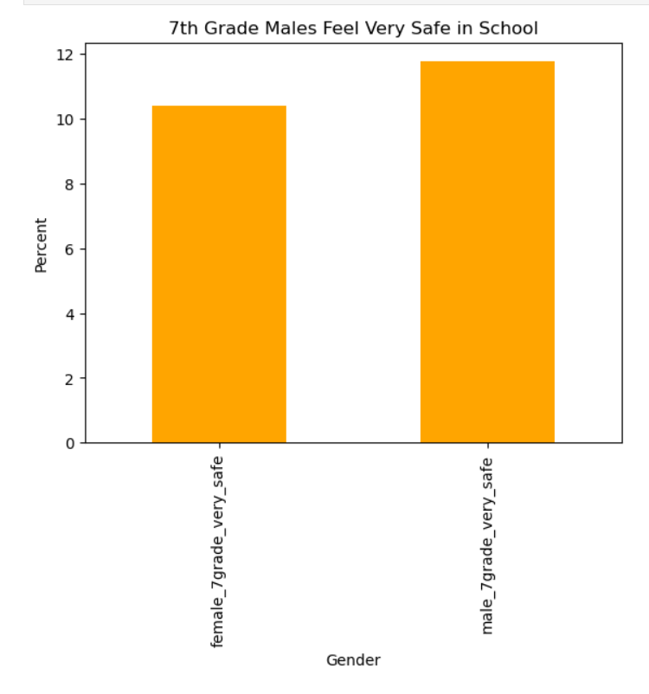
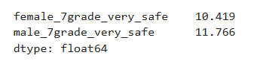
It is more likely for 7th grade males to feel safer than 7th grade females.

Slide 6

Does sexual orientation play a role in students feeling very unsafe in school?

Slide 7
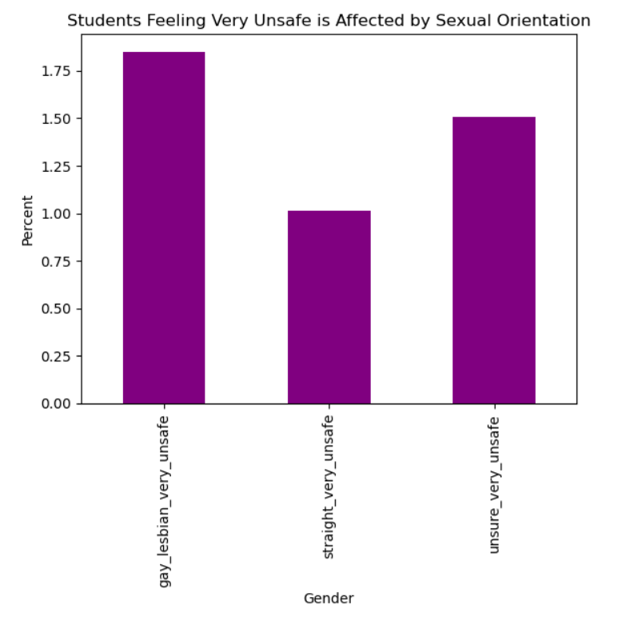
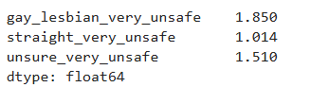
Students are more likely to feel very unsafe in school if they are gay or lesbian.

Slide 8

What is the breakdown of safety perception of students who have a low level of connectedness to school?

Slide 9
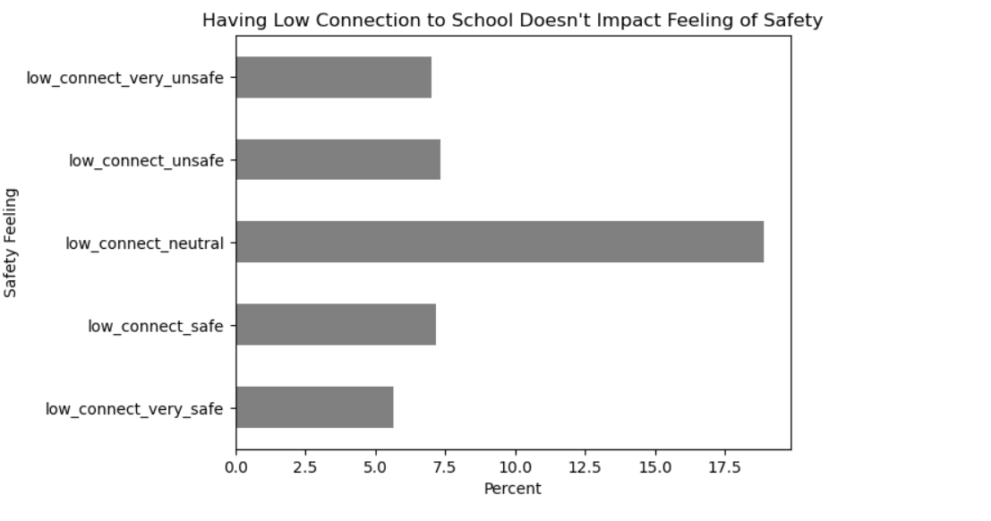
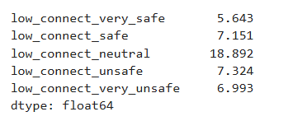
The majority of students who have a low connection to the school feel neither safe nor unsafe.

Slide 10

Does the parents’ level of education affect students who feel neither safe nor unsafe?

Slide 11
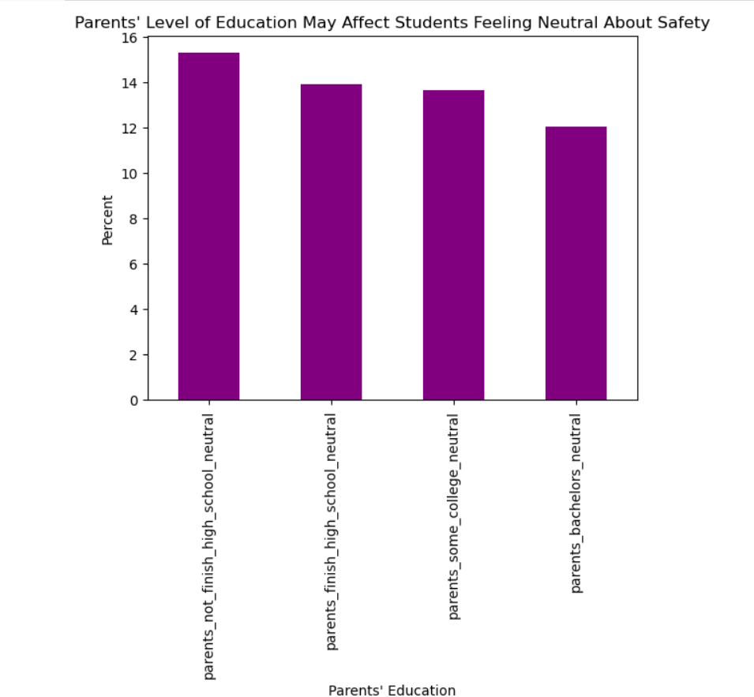
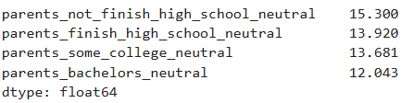
Students are more likely to have neutral feeling about their safety if their parents did not finish high school.

Slide 12

Does race play a role in students feeling safe?

Slide 13
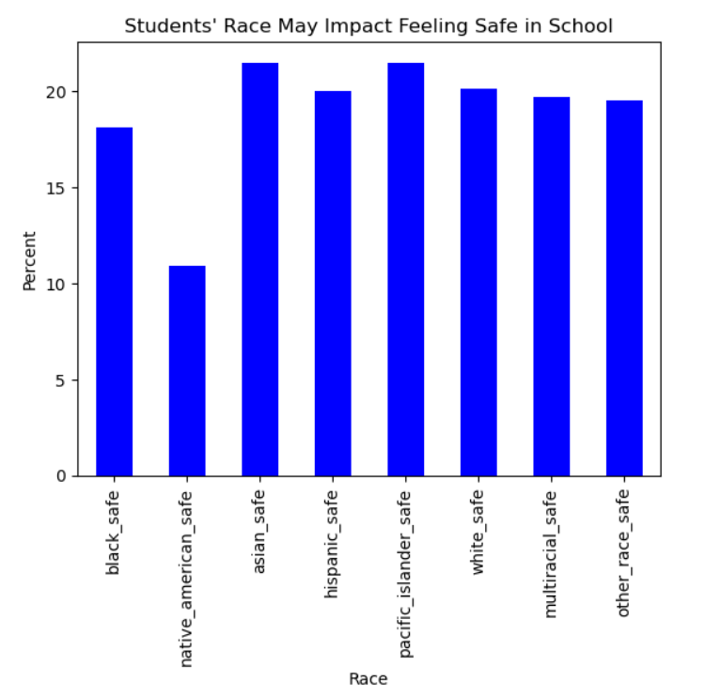
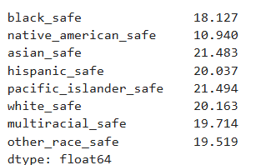
Native American students are less likely to feel safe in school compared to students of other races.

Slide 14


In conclusion
I would recommend some type of diversity and inclusion educational program. This program could highlight the different races of the student body and the students who are gay/lesbian.
To continue to analyze this data I would recommend a repeat survey. For example, this survey can be given once in the beginning and again at end of the school year to see how the scores change.

